Slide 1
Facility for Low Carbon Technology Deployment
Innovation Challenge
<Name of Company>
<Name of Innovation>

Slide 2
Instructions
Be precise and keep to indicated slide number limits
Provide complete details
Indicate all assumptions
Information in each slide should be presented in not more than 6 bullet points

Slide 3
About the Company
Max 2 slides

Slide 4
Brief Company Profile
Year of incorporation
Brief description of the company
Type of ownership
Management
Partnership with R&D or institutes if any
Revenues in 2019-20

Slide 5
About the Innovation
Max 8 slides

Slide 6
Technology Details
Brief information about the innovation (2 slides, include photographs and schematics)
Certifications/ patents/ IPR
Which aspect of Industrial IOT does this innovation fall under:
  Sensors
  Computation Systems
  Communication & Reporting
  Storage
  Latency End to End
  Data security
  Industrial automation
  Others

Slide 7
Innovation Details – part 1
Provide clear explanation of the innovation and technical aspects of your innovation
Which key issue / gap in the industry does this innovation address
Discuss your innovation from the perspective of process, technology, efficiency, cost, practicality.
Compare with other existing technologies that are used for the same purpose – clearly indicate differences.

Slide 8
Use case addressed by the Innovation
Use case* | Expected Outputs | (Yes/No)
Improve Energy Efficiency | Track and reduce idle running of equipment while not in use Track efficiency of equipment and Specific Energy Consumption of unit/plant
Energy saving through Production Optimization | Optimize the Production process Decrease interruptions in production processes, Scheduling manual/autonomous operations
Improve Productivity | Analytics, track machine conditions and reduce down time Monitor KPI to track production improve Track anomalies in Production process and quality of intermediate products to reduce rejection of finished product
Reduce Wastage of Raw materials and Emissions | Monitor, Input quality Control, Producing Quality Products Optimization of Resources utilized Monitor emission levels to meet Government Regulations
Maintenance | Condition based maintenance (CBM) Analytics, Optimization of Maintenance schedules

Slide 9
Provide details of the Use Cases addressed by Innovation
The Empowerment of personnel across different functions due to Industrial IoT deployment
Unified Dashboards and Real-Time Visibility
Drill-down of KPIs and inter-dependencies
The Technological reliability and commercial viability of Industrial IoT system proposed / deployed
Design of Time-series database and tag structures algorithms
Capability of Edge-Computing devices
Reliability and scalability of Industrial IoT and Cloud Platforms
Data Governance
Data storage and maintenance.
Data security in terms of protecting data from any unauthorized third-party access or malicious attacks and exploitation of data
Data privacy with respect to processing, storage and usage and rights
Sharing with Operational Roles

Slide 10
Innovation Benefits
Benefits & co-benefits expected
  Energy efficiency
  Productivity gains
  Wastage reduction
  Enhanced safety
Clearly outline the following (with brief calculations)
  Energy savings per annum
  Green House Gas (GHG) Emission savings per annum
  Cost savings per annum
  Other environmental benefits
Clearly share the assumptions for the above

Slide 11
Status of Innovation
Prototype drawings can be attached as PDF, but should not exceed 8 MB
If any installations have been completed, please indicate provide a detailed reference of the installation including:
  Location and plant name
  Installation details (technical and financial)
  Name, email id and phone number of contact person
  Photographs

Slide 12
Innovation Compliance
Max 2 slides

Slide 13
Functionality | Compliance (Specify yes/no, if yes provide details. | Technology Readiness Level
The Energy Saving Goal of Industrial IoT deployment in the core operational processes % Reduction of Energy Bill % Reduction of Cost of production Technology Readiness Level (refer diagram on next slide) (TRL **) Provide details of energy and engineering calculations, statistical computations | Yes/No
The Innovation achieved in across different use cases processes due to Industrial IoT deployment | Yes/No
The Empowerment of personnel across different functions due to Industrial IoT deployment Unified Dashboards and Real-Time Visibility Drill-down of KPIs and inter-dependencies | Yes/No
The Technological reliability and commercial viability of Industrial IoT system proposed / deployed Design of Time-series database and tag structures algorithms Capability of Edge-Computing devices Reliability and scalability of Industrial IoT and Cloud Platforms | Yes/No
** refer next slide

Slide 14
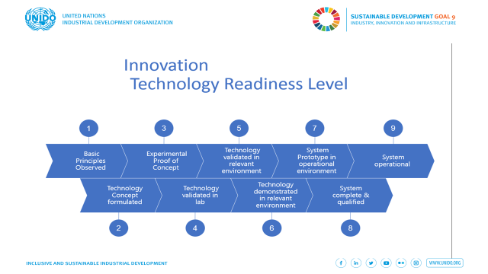

Slide 15
Viability & Market Potential
Max 6 slides

Slide 16
Cost of Technology
Total project cost/ economics end to end (include O&M)
Please also indicate any anticipated additions/ changes to the existing scheme for installation (and its relevant cost)– for example, any additional retrofit that may be required at the client’s location/plant/facility to accommodate the innovation

Slide 17
Technical/ Onsite Viability
Collaboration with existing technology suppliers
Impacts on existing technology/ O&M, guarantees, etc.
Are there conditions that may affect the operation? (e.g., weather, water, ambient conditions)
O&M details
How much time will it take for the equipment/solution to be designed and commissioned?

Slide 18
Financials
Investment Cost
Payback
Return on Investment

Slide 19
Market for the Innovation
Replication Potential of the Product
  Assuming no limit on your organization’s capacity, how many installations are possible in Indian industry?
Major Sectors to be targeted
Cross Sectoral Potential
Who are your competitors?
Please be specific – numbers, percentages, names, etc.

Slide 20
Scaling up of Innovation
Max 5 slides

Slide 21
Business Plan
Do you have a business plan?
Have you done a SWOT analysis?
How will you access markets/ new customers?
What is your sales strategy?
Funding requirements?

Slide 22
FLCTD Support
If selected under the FLCTD project, what is support that you require – (a) product/solution development or (b) support for commercialization?
What other support do you expect from FLCTD?

Slide 23
Contact Details
Please provide your full contact details

